Slide 1
Working with Objects

Slide 2
Identifying Persistent Object States
Hibernate defines four object states:
transient
persistent
detached
removed.

Slide 3
Transient Objects
Objects instantiated using the new operator are called transient objects.
The Hibernate persistence context isn’t aware of operations performed on transient objects.
Their state is lost when they aren’t referenced by any other object and become available for garbage collection.
They don’t have any association with any database table row.
JPA doesn’t have this state.

Slide 4
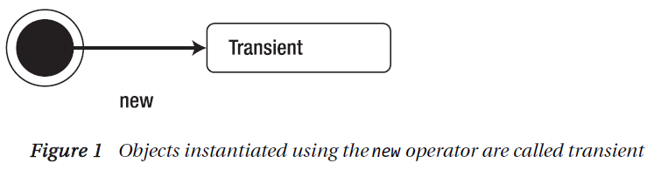
Transient Objects

Slide 5
Persistent Objects
An object that has a database identity associated with it is called a persistent object.
The key for an object to be in a persistent state is to be associated with a persistent context.
The persistent context caches the object state and can identify changes made, if any.

Slide 6
Persistent Objects
You can create persistent objects two ways: you can retrieve a database table row as an entity by calling API methods like get(), load(), and list(); or you can persist a transient object using API methods like save() and saveOrUpdate().

Slide 7
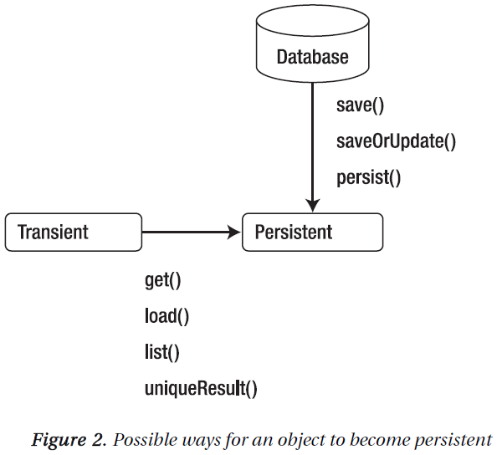
Persistent Objects

Slide 8
Detached Objects
The persistent context no longer exists after the transaction is closed.
If the application retains a reference to the persistent object, then the object is said to be in the detached state.
The state of a detached object can be modified and can be persisted back to the database.
This is very common when you’re working with applications that have a multilayered architecture.

Slide 9
Detached Objects
Hibernate provides a reattached mode and a merging mode to make a detached object persistent.
JPA has merging mode only.
Figure 3 illustrates the relationship between detached and persistent objects.

Slide 10
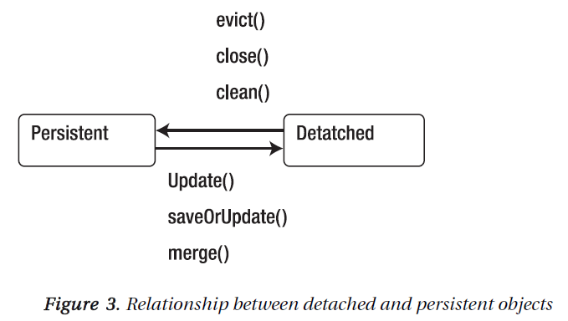
Detached Objects

Slide 11
Removed Objects
A persistent object is considered to be in the removed state when a delete() or remove() operation is called on it.
The delete() method is provided by a Hibernate session, whereas the remove() method is provided by the JPA EntityManager.

Slide 12
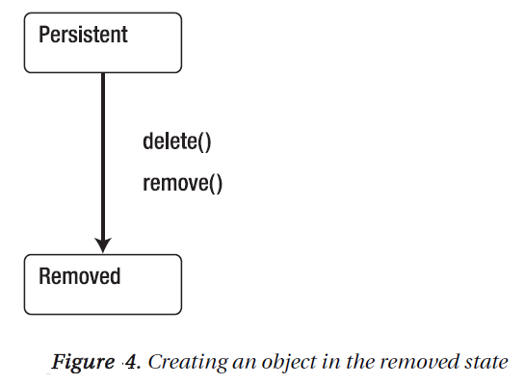
Removed Objects

Slide 13
Working with Persistent Objects
The Session interface provides methods to perform CRUD operations on an entity to make it a persistent object.

Slide 14
Creating a Persistent Object
Transaction tx = session.beginTransaction();
Book book = new Book();
book.setName("Book Name - hibernate ");
book.setPrice(79);
book.setPublishDate(new Date());
Serializable bookId = session.save(book);
tx.commit();
session.close();
Notes:
The save() method returns the primary key of the newly inserted record. Only by calling commit()
on the transaction is a database connection created and a record inserted into the database. The last line
closes the session, which means its persistent context is no longer active. The book object is now in a
detached state.

Slide 15
Retrieving a Persistent Object
Session session = getSession();
Transaction tx = session.beginTransaction();
//Book book = (Book) session.load(Book.class, new Long(294912));
Book book1 = (Book) session.get(Book.class, new Long(294912));
tx.commit();
session.close();
System.out.println(book1);

Slide 16
Retrieving a Persistent Object
The get() method makes a call to the database and does a lookup for the primary key. If it finds the primary key, it retrieves and returns the object. If it can’t, it returns null.
The load() method, on the other hand, looks in the current persistence context. If it can find the entity, it returns the entity object. If the object isn’t being managed in the current persistence context, then a proxy placeholder is returned without hitting the database.
Notes:
This means if you request an entity
object that isn’t in the database (or, of course, the current persistence context), then the load() method
returns a proxy. You get an org.hibernate.ObjectNotFoundException when you try to read/retrieve
properties other than the primary key within the same persistence context, and you get an
org.hibernate.LazyInitializationException when you try to read/retrieve properties after the session
is closed (the persistence context has ended).

Slide 17
Modifying a Persistent Object
You can modify any persistent object that is associated with a session and a persistence context. Its state is then synchronized with the database:
Session session = getSession();
Transaction tx = session.beginTransaction();
Book book = (Book) session.get(Book.class, new Long(294912));
book.setName("Book Name - hibernate 2");
tx.commit();
session.close();
Notes:
The entity is retrieved from the database and modified in the same transaction. The modifications
are propagated to the database when the commit() method is called. The persistence context identifies
the changes that have been made to the entity’s state and synchronizes with the database. This is called
automatic dirty checking.

Slide 18
Deleting a Persistent Object
You can delete from the database any persistent object that is associated with a session and a persistence context.
To do so, you call the delete() method:
Session session = getSession();
Transaction tx = session.beginTransaction();
Book book = (Book) session.get(Book.class, new Long(294912));
session.delete(book);
tx.commit();
session.close();
Notes:
The entity is in the removed state after the call to delete(). The database record is deleted after the
transaction is committed, and the object is in the transient state after the session is closed.

Slide 19
Persisting Detached Objects
You can persist a detached object two ways:
by reattaching it or
by merging it.

Slide 20
Reattaching a Detached Object
Session session = getSession();
Transaction tx = session.beginTransaction();
Book book = (Book) session.get(Book.class, new Long(294912));
tx.commit();
session.close();
book.setName("Detached Hibernate");
Session session2 = getSession();
Transaction tx2 = session2.beginTransaction();
session2.update(book);
tx2.commit();
session2.close();
Notes:
Hibernate keeps track of modifications made to the detached object. Hence, when the update()
method is called, it always schedules an update SQL command. If you don’t want to make an update call,
you can configure the class mapping to have select-before-update='true'. Then, a get() call is made
to check whether the object has been updated , before the call to the update() method.
JPA doesn’t have an update() method. It only supports merging detached objects.

Slide 21
Merging a Detached Object
Session session = getSession();
Transaction tx = session.beginTransaction();
Book book = (Book) session.get(Book.class, new Long(294912));
tx.commit();
session.close();
book.setName("Detached Hibernate");
Session session2 = getSession();
Transaction tx2 = session2.beginTransaction();
Book book2 = (Book) session2.merge(book);
tx2.commit();
session2.close();
Notes:
In Hibernate, you use the session’s merge() method to persist a detached object. The merge() method
call results in a complex set of actions. Hibernate first looks to see if the instance of the entity is in the
current persistence context. If it finds an instance of the entity equal to the detached object, then it
copies the state from the detached object to the instance in the persistence context:

